Slide 1



PROGRESSIVE EDUCATION SOCIETY'S
MODERN COLLEGE OF ENGINEERING, PUNE-5
DEPARTMENT OF INFORMATION TECHNOLOGY PRESENT'S
Project Based Learning Presentation on
Electricity Billing System
Group Members :
Yash Bhombe
Sahil Karamkar
Shivam Ghaware
Nilesh Khude
Vaibhav Adhe
Mentor : Prof. Shoma Mitkari

Slide 2
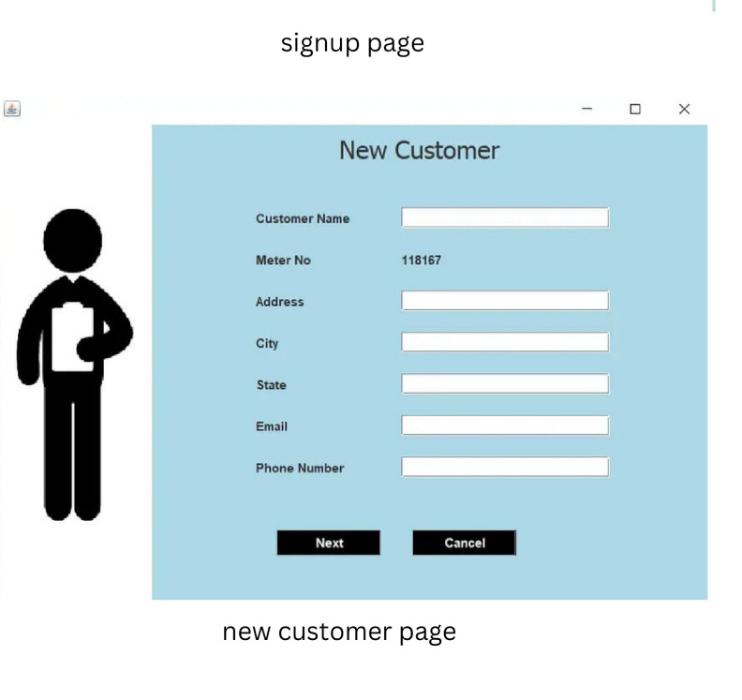

Slide 3

Problem Statement
The bills is to be maintained with hands the process of keeping and maintaining the information is very tedious and lengthy to customer. It is very time consuming and laborious process because, staff need to be visited the customers place every month to give the bills and to receive the payments. For this reason, we have provided features Present system is partially automated (computerized), existing system is quite laborious as one must enter same information at different places.

Slide 4
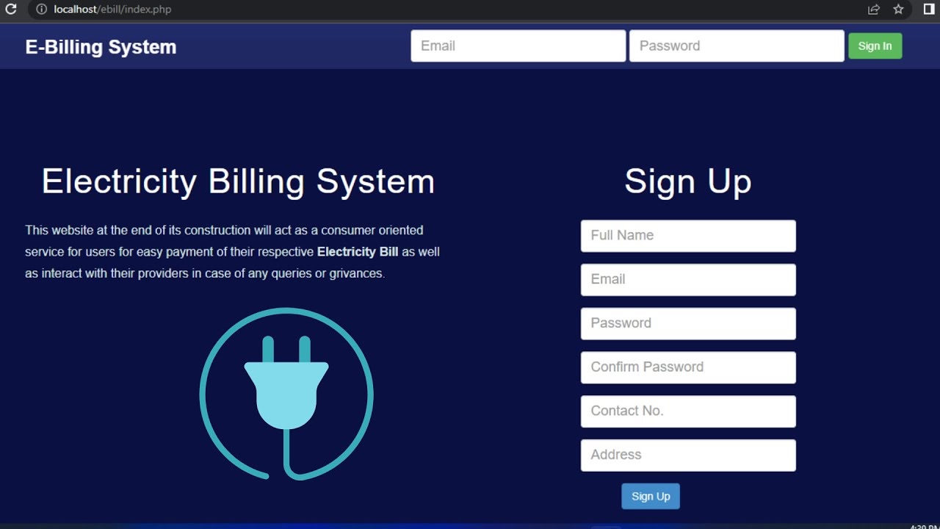
Introduction
We all know how important it is to keep accurate and up-to-date electricity bill records. Electricity billing systems are designed to help us do just that.
Electricity billing systems play a vital role in the electricity and power industry, enabling power companies to manage and bill their customers for the amount of electricity consumed. These systems have revolutionized the way electricity billing is done, moving away from traditional paper-based billing methods to digital and automated billing systems.
The system offers a user-friendly interface, a secure payment system, and an automated billing process, ensuring that bills are generated accurately and quickly.

Slide 5
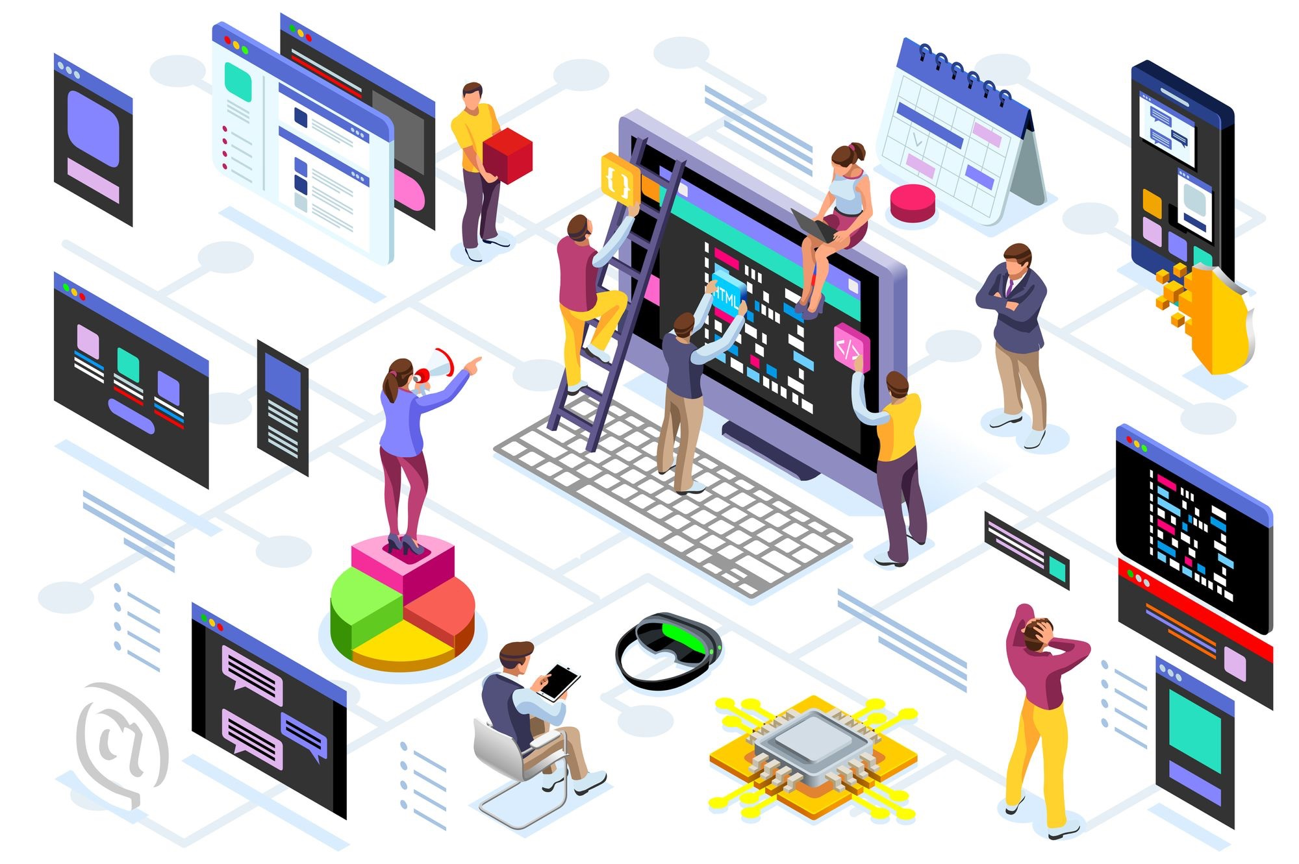
Features of an Electricity Billing System.
Increased efficiency : The system automates the billing process, reducing the time and effort required to generate and distribute bills.
Improved data management : The system provides a centralized location for customer billing and payment data, making it easier for companies to manage and analyze this data.
Reduced costs : The system eliminates the need for manual billing processes, reducing the costs associated with paper bills, postage, and manual payment processing.

Slide 6
Customer Management: The system allows the utility company to manage customer information, including personal details, contact information, and billing preferences. Meter Reading: The system enables the recording and management of meter readings to measure the amount of electricity consumed by customers. This can be done manually by meter readers or automatically through smart meters.
Billing Calculation: The system performs complex calculations based on meter readings and tariff rates to determine the amount of electricity consumed by each customer during a billing period. It factors in variables such as peak hours, off-peak hours, and any applicable discounts or penalties

Slide 7
Invoice Generation: Once the billing calculations are completed, the system generates detailed invoices or bills for each customer. These bills typically include information such as the consumption period, meter readings, tariff rates, total charges, taxes, and any additional charges or adjustments. Payment Processing: The system provides various payment options for customers, including online payment gateways, bank transfers, and physical payment methods. It may also support automatic payment scheduling and recurring billing for convenience.

Slide 8
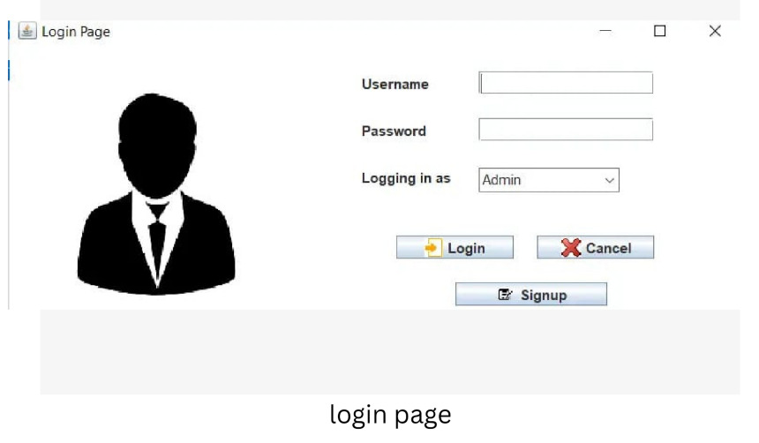

Slide 9
Modules
User Management Module: This module focuses on managing user-related information, such as customer details, contact information, billing addresses, and account preferences. It enables the creation, modification, and deletion of user records, as well as authentication and access control mechanisms.
Meter Reading Module: The meter reading module handles the collection and storage of electricity consumption data from the meters installed at customer premises. It may involve integrating with hardware components, such as smart meters or manual data entry systems, to capture accurate readings at regular intervals.
Billing and Invoicing Module: This module calculates electricity consumption charges based on meter readings and applicable tariff rates. It generates bills or invoices for customers, taking into account factors like consumption history, applicable taxes, and any additional charges. The module also handles invoice distribution, payment tracking, and

Slide 10
Data Storage and Backup Module: This module manages the storage and retrieval of all electricity billing-related data, including user information, meter readings, tariff details, billing records, and payment history. It ensures data integrity, security, and backups to prevent data loss and supports efficient data retrieval for reporting or auditing purposes.
Payment Processing Module: The payment processing module facilitates the handling of customer payments, including online payments, bank transfers, or manual payment collection. It integrates with payment gateways, tracks payment status, updates customer accounts, and generates receipts or payment confirmations.

Slide 11
Flow of The Project
Requirements Gathering - Understand project scope and objectives. - Gather requirements from stakeholders.
Database Design - Identify entities and attributes. - Create a database schema.
Database Creation - Install the database management system. - Create tables and define keys.
Java Application Development - Set up Java development environment. - Develop Java classes for database interaction.
Database Connectivity - Use JDBC for database connection. - Execute SQL queries.
User Interface Development - Design GUI using Java Swing. - Implement event handling.

Slide 12
7. Testing and Debugging - Test application and fix issues. - Validate data integrity.
8. Documentation and Deployment - Create project documentation. - Package application and deploy.
9. Maintenance and Updates - Provide ongoing support. - Incorporate feedback for improvements.

Slide 13
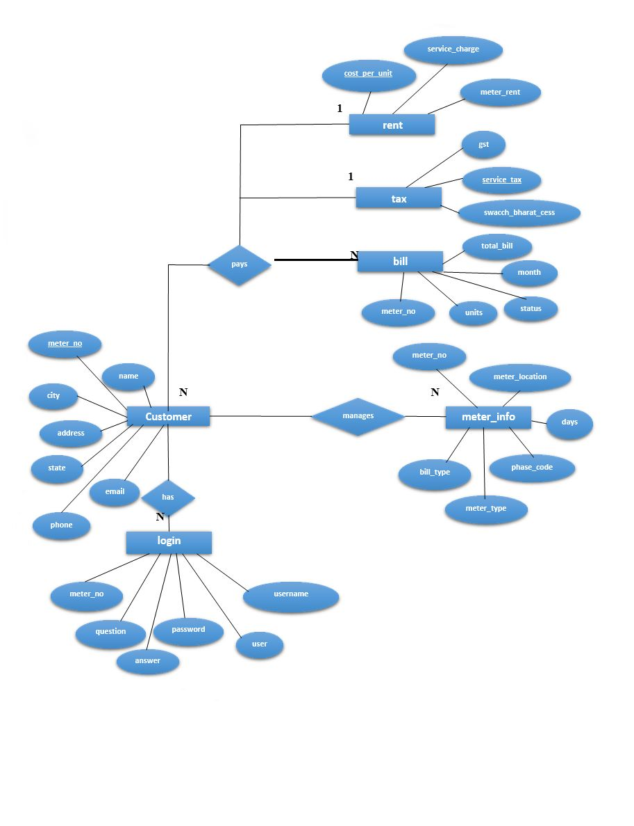
EE Diagram

Slide 14
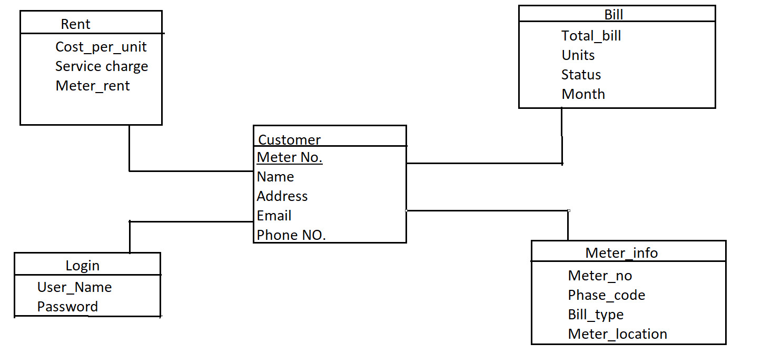
Schema Diagram

Slide 15
Table: Customers
Columns: customer_id (primary key), first_name, last_name, address, contact_number, email
Table: Meters
Columns: meter_id (primary key), customer_id (foreign key referencing Customers table), meter_number, meter_type, installation_date
Table: Readings
Columns: reading_id (primary key), meter_id (foreign key referencing Meters table), reading_date, reading_value
Table: Rates
Columns: rate_id (primary key), rate_type, rate_per_unit
Table: Invoices
Columns: invoice_id (primary key), customer_id (foreign key referencing Customers table), invoice_date, due_date, total_units, total_amount

Slide 16
References
Samad, M. R. , Islam, M. M. , & Rahman, M. S. (2018). Development of an electricity billing system using ZigBee technology. International Journal of Computer Applications, 181(1), 25-29.
Tripathi, V. , & Tiwari, P. (2018). An automated electricity billing system using IOT. International Journal of Computer Science and Information Technologies, 9(1), 241-246.
Chong, C. , & Lee, T. (2017). Development of an electricity billing system based on smart grid infrastructure. IEEE Transactions on Smart Grid, 8(2), 978-985.
Radhakrishnan, S. , & Aravind, R. (2015). Electricity billing system for electrical loads using GSM technology. International Journal of Advanced Research in Electrical, Electronics and Instrumentation Engineering, 4(2), 874-877.
Arumugam, R. (2014). Design and implementation of a prepaid electricity billing system using RFID. International Journal of Scientific and Research Publications, 4(2), 1-6.
Zhu, Q. , Zhang, Y. , & Liao, H. (2013). An online electricity billing system for smart grid based on wireless sensor networks. Journal of Networks, 8(5), 1127-1134.

